Slide 1
Graphs

Slide 2
Terminology
A graph is a collection of nodes, called vertices and
a collection of line segments connecting pairs of
Vertices, called lines.
Graphs may be either directed or undirected.
A directed graph is a graph in which each line has a
direction(arrow head) to its successor.
The lines in a directed graph are known as arcs.
In a directed graph, the flow along the arcs between
two vertices can follow only the indicated direction.

Slide 3
An Undirected graph is a graph in which there is no
Direction on the lines, known as edges.
In an Undirected graph, the flow between two
Vertices can go in either direction.
Two vertices are said to be adjacent vertices (or
neighbors) if there exists an edge that directly
connects them .
Ex : In the figure given below A and B are adjacent
while D and F are not.
A path is a sequence of vertices in which each
vertex is adjacent to the next one.
Ex : A,B,C,E is one path and A,B,E,F is another.

Slide 4
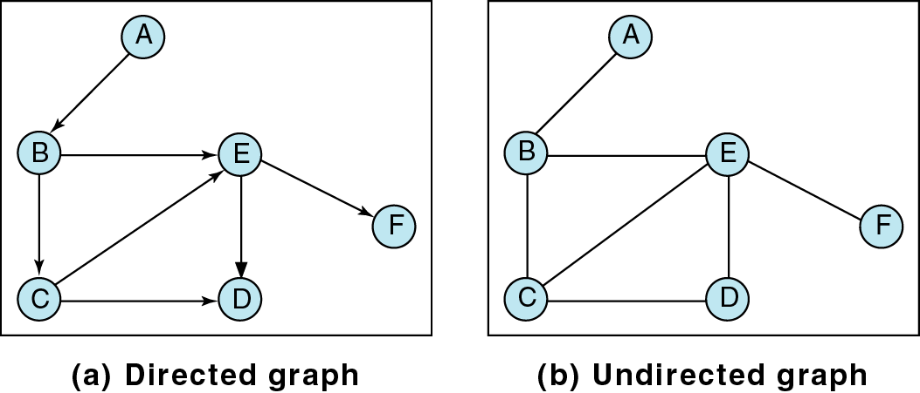
Figure 12-1

Slide 5
A cycle is a path consisting of at least three vertices
that starts and ends with the same vertex.
Ex : In the above figure B, C, D, E, B is a cycle.
A loop is a special case of a cycle in which a single arc begins and ends with the same vertex. In a loop the end points of the edge are the same.
Two vertices are said to be connected if there is a path between them.
A graph is said to be connected if, supressing direction, there is a path from any vertex to any other vertex.
A directed graph is strongly connected if there is a
Path from each vertex to every other vertex in the digraph.

Slide 6
A directed graph is weakly connected when there are atleast two vertices that are not connected.
A graph is disjoint if it is not connected .
The degree of a vertex is the number of lines incident to it.
Ex : the degree of vertex B is three and the degree of
the vertex E is four.
The outdegree of a vertex is the number of arcs leaving the vertex.
The indegree is the number of arcs entering the vertex.
Ex : The indegree of vertex B is one and its outdegree is two.
The indegree of vertex E is 3 and its outdegree is one.

Slide 7
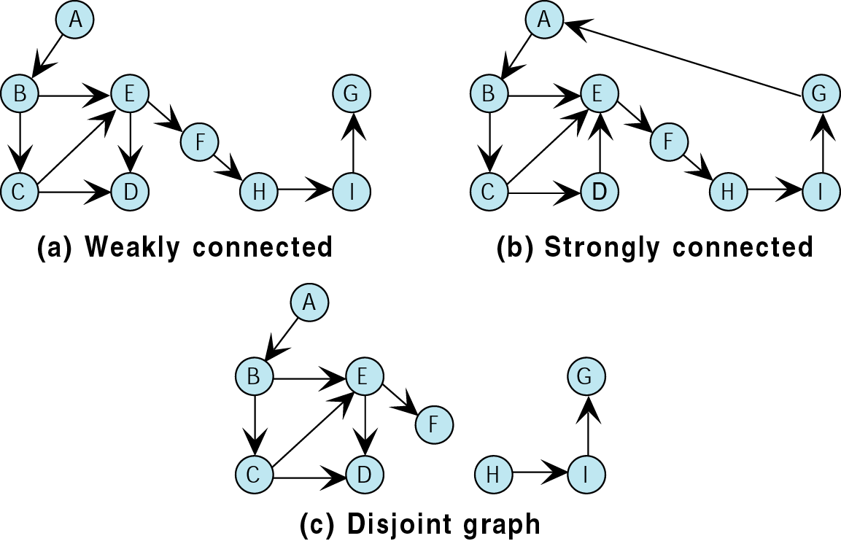
Figure 12-2

Slide 8
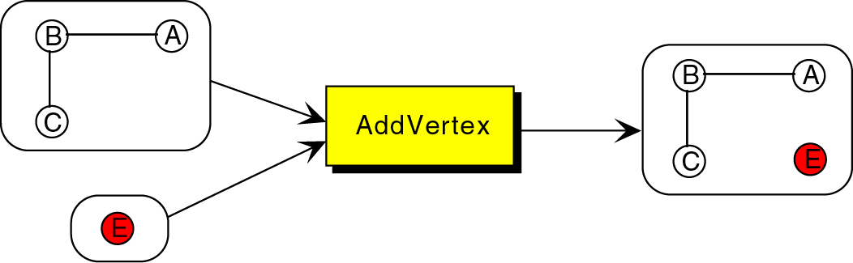
Figure 12-3

Slide 9
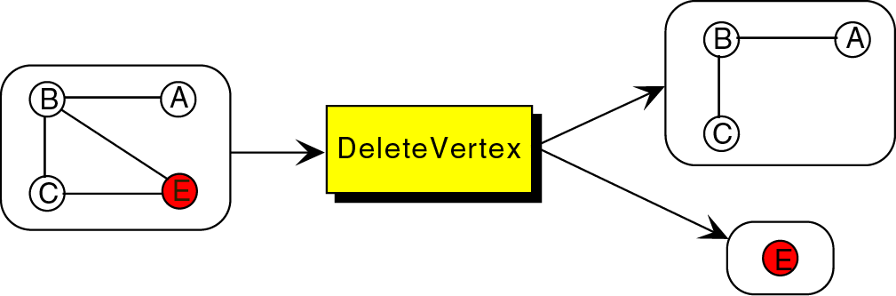
Figure 12-4

Slide 10
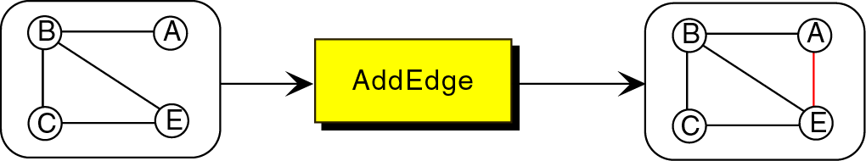
Figure 12-5

Slide 11
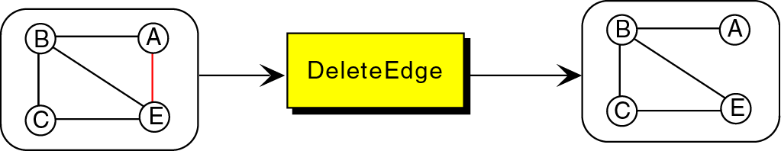
Figure 12-6

Slide 12
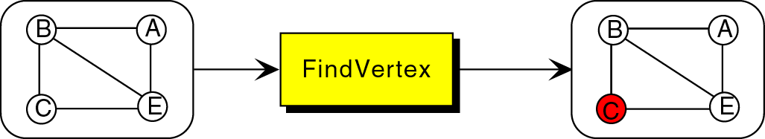
Figure 12-7

Slide 13
Depth-first traversal
In the Depth-first traversal, all of vertex’s
descendents are processed before we move to an
Adjacent vertex.
The depth-first traversal of a graph starts by
processing the first vertex of the graph. After
processing the first vertex, we select any vertex
adjacent to the first vertex and process it. As each
vertex is processed, we select an adjacent vertex until
we reach a vertex with no adjacent entries.

Slide 14
For performing depth-first traversal a stack is used
where the traversal will process adjacent vertices in
Descending LIFO order.
Procedure :
We begin the traversal by pushing the first vertex,
into the stack.
2) We then loop, popping the stack and processing the
Vertex , pushing all of the adjacent vertices into the
stack.
3) When the stack is empty, the traversal is complete.

Slide 15
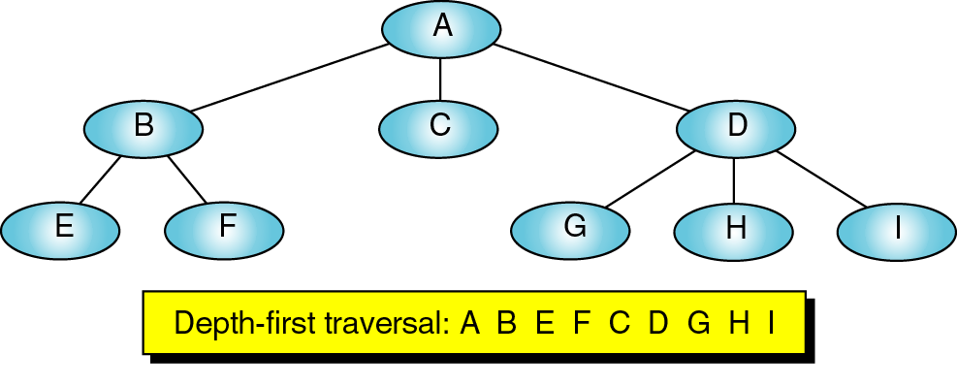
Figure 12-8

Slide 16
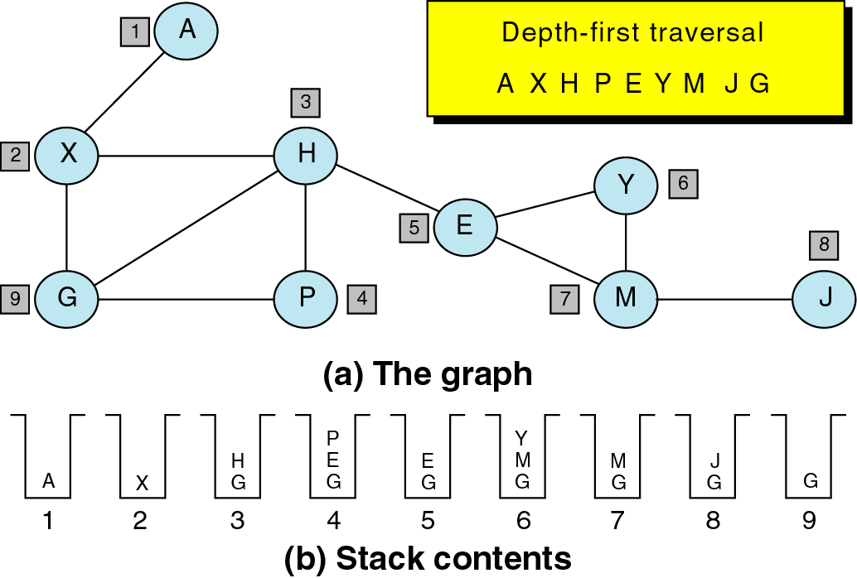
Figure 12-9

Slide 17
Algorithm depthFirst(GRAPH *graph,)
If (empty graph)
Return
2) Set processed flags to not processed
Walkptr = graph → first;
Walkptr = Walkptr → nextVertex;
3) Process each vertex in the list
Stack = createStack()
Walkptr = graph → first;
loop( Walkptr not null)

Slide 18
If (Walkptr →processed < 2)
If (Walkptr → processed < 1)
// Push and set flag to stack
pushStack(stack, Walkptr)
Walkptr → processed = 1
// process vertex at stack top
Loop (not emptystack)
Vertexptr = popstack(stack)
Process(vertexptr →dataptr)
Vertexptr → processed = 2
// push all vertices from adjacency list

Slide 19
arcWalkptr = vertexptr → arc
Loop(arcWalkptr not null)
vertToptr = arcWalkptr → destination
If (vertToptr → processed is 0)
Pushstack(stack, vertexToptr)
vertToptr → processed = 1
arcWalkptr = arcWalkPtr → nextArc
Walkptr = Walkptr → nextVertex
Destroystack(stack)
Return
}

Slide 20
Breadth first traversal
In the breadth-first traversal, all adjacent vertices are
processed before processing the descendents of a
vertex(i.e before going to the next level).
We begin the traversal by picking a starting vertex and
after processing it , we process all of its adjacent
Vertices. When all of the adjacent vertices have been
Processed, we pick the first adjacent vertex and process
all of its vertices, then the second adjacent vertex and
Process all of its vertices and so on until no vertex is to
be processed.

Slide 21
Procedure :
We begin by enqueuing the starting vertex in the
Queue.
2) We then loop, dequeuing the queue and processing
the vertex from its adjacent vertices into the queue.
3) When the queue is empty, the traversal is complete.

Slide 22
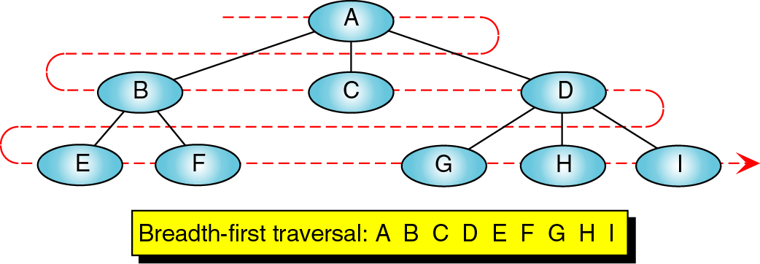
Figure 12-10

Slide 23
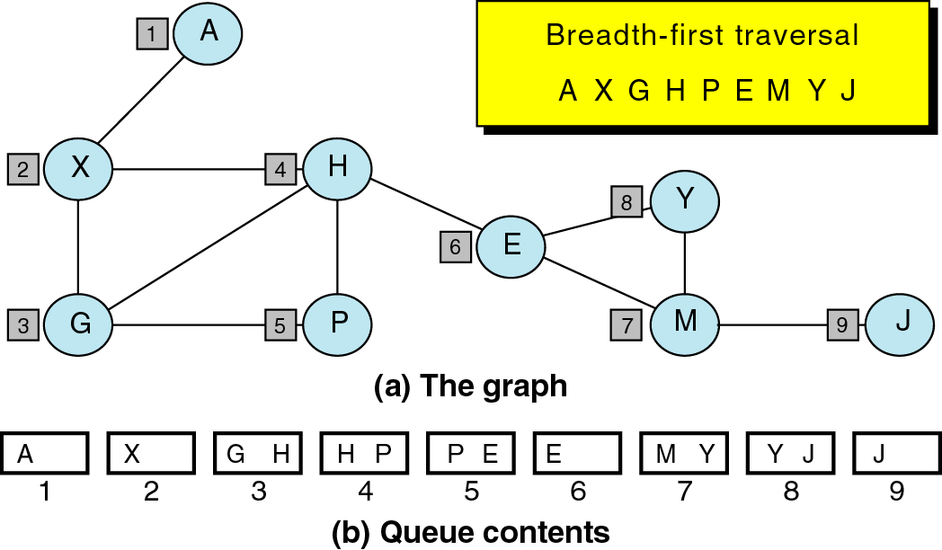
Figure 12-11

Slide 24
Algorithm breadthFirst(GRAPH *graph)
If (graph → first null)
Return
2) // flag 0 : not processed, flag 1 : enqueued
flag 2 : processed
queue = createqueue
Walkptr = graph → first;
Loop (Walkptr not null)
Walkptr → processed = 0;
Walkptr = walkptr → nextVertex
3) Process each vertex in the vertex list

Slide 25
Walkptr = graph → first;
Loop (Walkptr not null)
If (Walkptr → processed < 2)
If (Walkptr → processed < 1
// enqueue and set process flag to queued (1)
Enqueue(queue, Walkptr)
Walkptr → processed = 1
// Now process descendants of vertex at queue front
Loop (not emptyqueue (queue))
Dequeue(queue, vertexptr)
// process vertex and flag as processed

Slide 26
Process(vertexptr)
Vertexptr → processed = 2
// enqueue all vertices from adjaceny list
arcptr = vertexptr → arc
Loop (arcptr not null)
toptr = arcptr → destination
If (toptr → processed zero)
Enqueue(queue, toptr)
toptr → processed = 1
arcptr = arcptr → nextArc
Walkptr = Walkptr → nextVertex
Destroyqueue(queue)
Return
}

